Slide 1
Google slides: Online Presentation tool
Testing Types

Slide 2
AGENDA
Smoke testing
Functional testing
Positive testing
Negative testing
Integration testing
Non-functional testing: UI
Performance testing
Load testing
Stress testing
Localization testing

Slide 3
Smoke testing
  Requirement: As a User, I need to have ability to enter Google Slides.
  Smoke Testing Procedure: 1. Open URL: https://docs.google.com/presentation/u/0/
  Expected result:
  The Main page is opened, but you need google mail to enter.

Slide 4
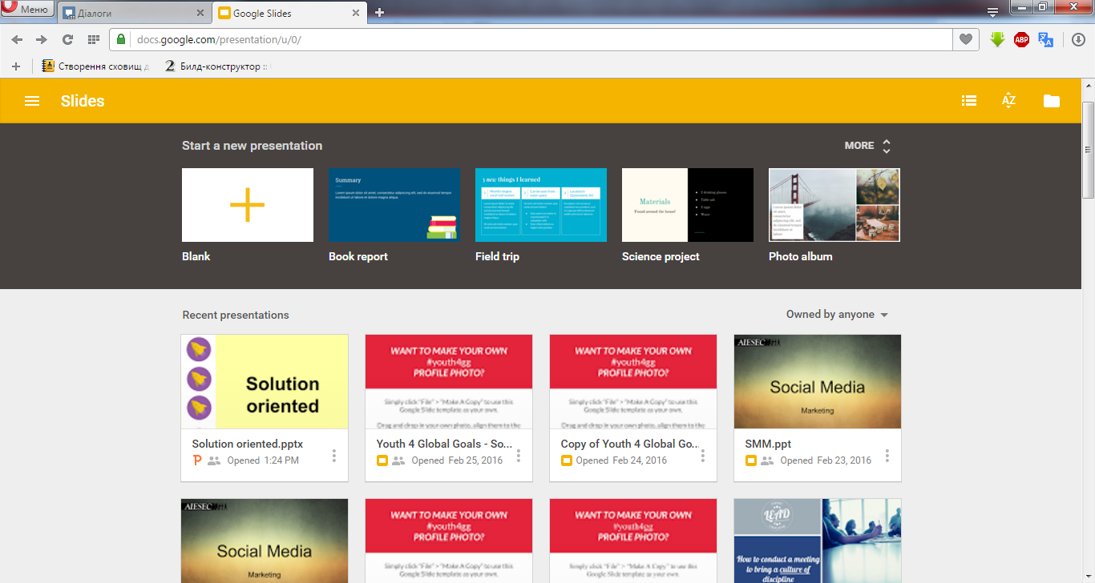

Slide 5
Functional testing
Requirement: As a User I want to use template for my presentation, so then I can create my presentation easier.
Functional Testing Procedure:
1. Open https://docs.google.com/presentation/u/0/
2. Type valid values for registered user into ‘Email’, ‘Password’ fields
3. Click on ‘Log in’ button
4. Press on any template
5. Wait for few seconds, while template will be loaded and you can start your presentation creation.
Expected result:
Chosen template will be loaded suсcessfully.

Slide 6
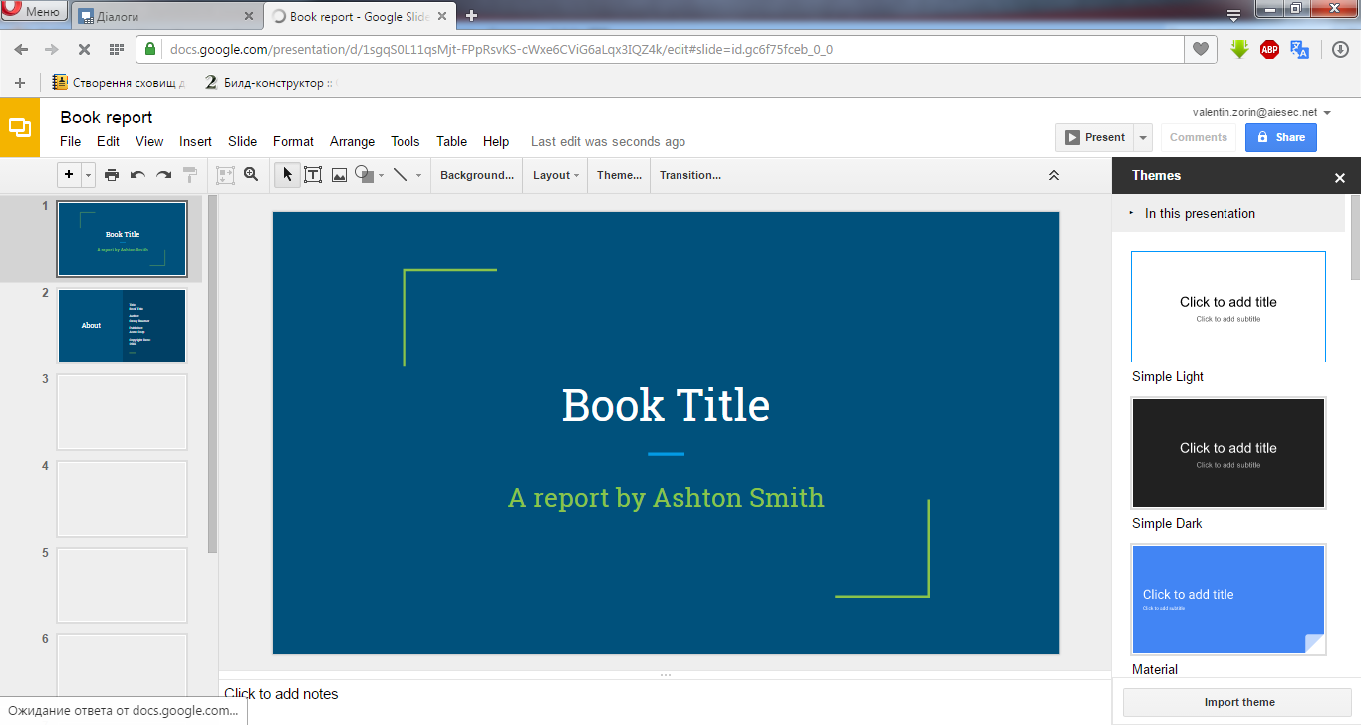

Slide 7
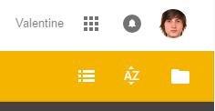
Positive testing
  Requirement: As a registered User, I want to have possibility to enter the system.
  Positive Testing Procedure:
  Open URL: https://docs.google.com/presentation/u/0/
  Type valid values into ‘Email’, ‘Password’ fields
  Press ’Log in’ button
Expected result:
Registered User logged in successfully.

Slide 8
Negative testing
Requirement:
As a User I should enter at least 8 characters into ‘Password’ field to log in.
Negative Testing Procedure:
1. Open URL: https://docs.google.com/presentation/u/0/
2. Type valid values into First name’, ‘Last name’, ‘Email’ fields
3. Put 5 characters into ‘Password’ field
4. Press Log In’ button
Expected result:
Error message ‘Password or Login was incorrect ’
appears below corresponding field.
‘Password’ field is highlighted with red color.
‘x’ sign appears on the right side of ‘Password’ field.
Entered characters transformed in bullets at once after entering.

Slide 9
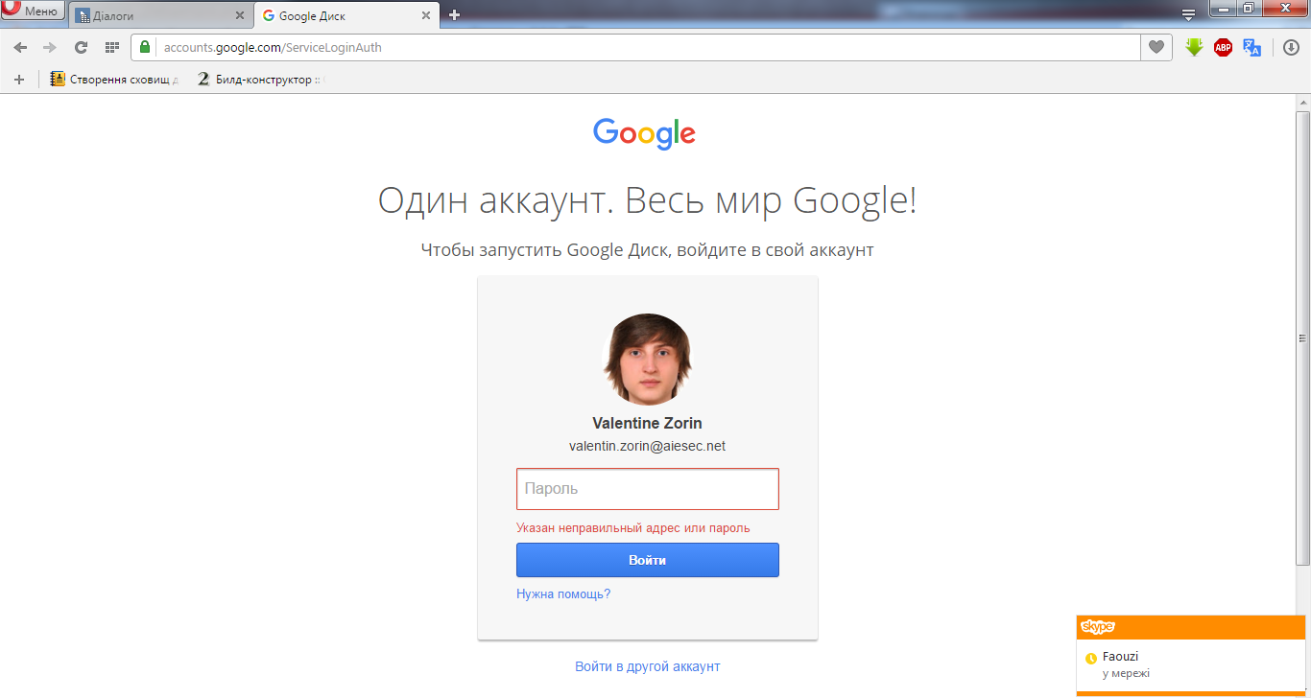

Slide 10
Integration testing
Requirement: After creating free Public account in Google the User can log in the system with his own account & profile.
Integration Testing Procedure:
1. Open URL: https://accounts.google.com/ServiceLoginAuth
2. Type valid values into ‘Email’, ‘Password’ fields
3. Push ‘Login’ button
Expected result:
Registered User logged in successfully.
If you fill all values correctly you should see.

Slide 11
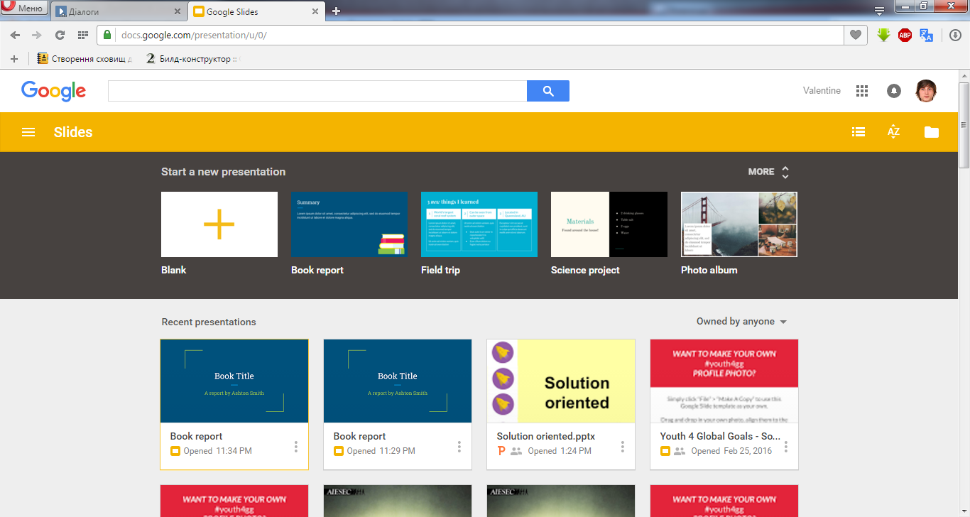

Slide 12
Non-functional testing: UI
Requirements: As a registered User I want to have my menu with ‘First’ name and photo in the right corner of the header.
UI Testing Procedure:
1. Open URL: https://docs.google.com/presentation/u/0/
2. Type valid values for registered user into ‘Email’, ‘Password’ fields
3. Press ’Log in’ button
4. Observe the right corner of the header
Expected result:
The Menu is located in the top right corner of the Google main page.
The ‘Menu’ label consists of User’s First name and photo in one line sign at the end. The Menu is always enable.

Slide 13


Slide 14
Performance testing
Requirement: As a User I want to have respond from the system in less than 10 sec after pressing ‘New Slide’ button on the ‘Your Google Slide’ page.
Performance Testing Procedure:
1. Open URL: https://docs.google.com/presentation/u/0/
2. Type valid values for registered user into ‘Email’, ‘Password’ fields
3. Press ’Log in’ button
4. On the Google slide page press button ‘New Slides ’
5. Measure spent time in seconds
Expected result:
The system responds in less than 10 sec.
Result:
The system responds in more than 10 sec, but it depends on your internet connection (mine was not so fast and fury).

Slide 15
Load testing
Requirement: As a System I need to support the work of 1000+ users simultaneously.
Load Testing Procedure:
1. Open https://docs.google.com/presentation/u/0/
  2. Type valid values for registered user into ‘Email’, ‘Password’ fields
3. Click on ‘Log in’ button
4. Press ‘New Slides’ button
5. Repeat steps 1-4 1000 times (By using Selenium)
Expected result:
1000 users can work simultaneously.

Slide 16
Stress testing
Requirement: As a System I need to support the work of 10000 users simultaneously.
Stress Testing Procedure:
1. Open https://docs.google.com/presentation/u/0/
  2. Type valid values for registered user into ‘Email’, ‘Password’ fields
3. Click on ‘Log in’ button
4. Press ‘New Slides’ button
5. Repeat steps 1-4 20000 times (use automation tool)
Expected result:
10000 users can work simultaneously.
Other 10000 users will get Error message:
‘The service is temporary unavailable.
Please try again later.’

Slide 17
Localization testing
Requirement: As a User I want to change the language on the login page, so all textual information should be translated into selected language.
Localization Testing Procedure:
1. Open https://docs.google.com/presentation/u/0/
  2. Type valid values for registered user into ‘Email’, ‘Password’ fields
3. Click on ‘Log in’ button
4. Observe Login page – English Language (by default)
5. Choose German Language on the footer
6. Check all textual information on the page whether it is translated into German
Expected result:
All textual information on the page
is translated into selected language.

Slide 18
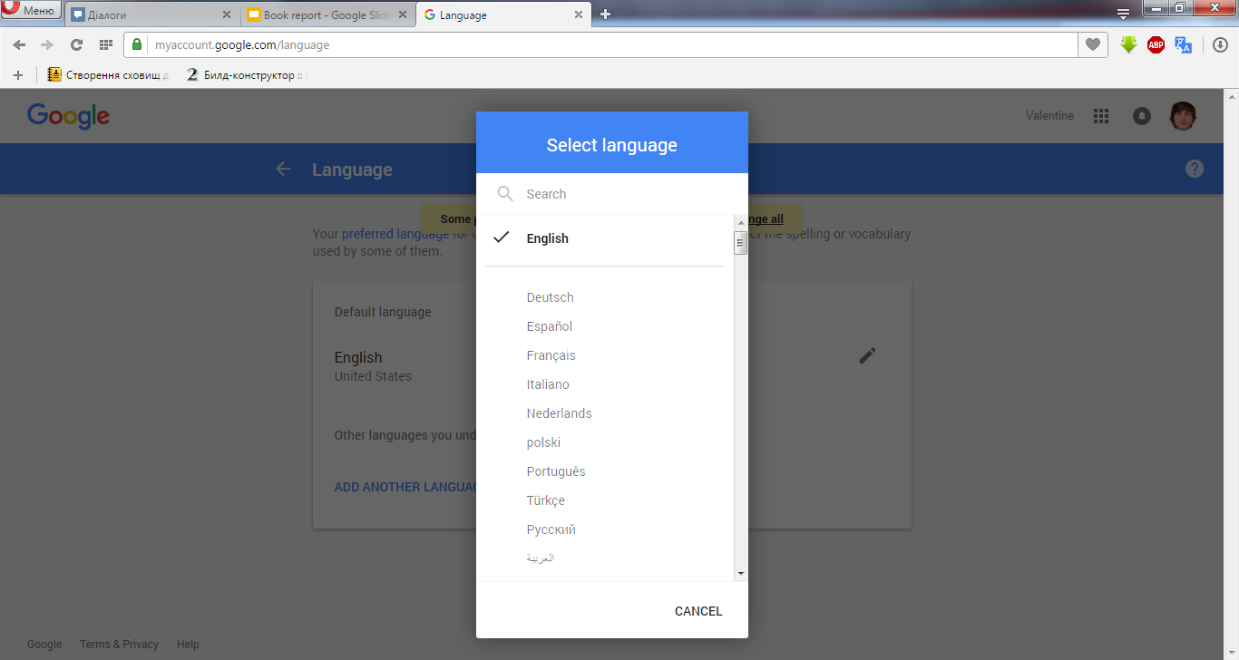

Slide 19
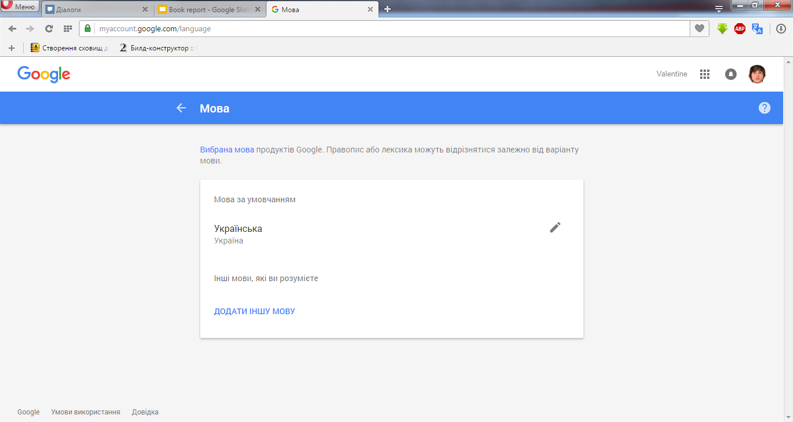

Slide 20
Дякую за Увагу.

